Slide 1

Express.js
A fast, unopinionated, minimalist web framework for Node.js.
Express is one of the most popular Node.js frameworks. It makes backend development faster, easier, and more organised, serving as the de facto standard for building server-side applications with Node.js.

Slide 2



Foundation of Modern Web Applications
Express.js is a key component of the MEAN, MERN, and MEVN stacks, providing a lightweight yet powerful foundation for web and mobile development. Its simplicity and flexibility are key reasons for its widespread adoption.
Lightweight Web Application Framework
Simplifies Server-Side Development
Robust Features for Web and Mobile Apps
Express provides a minimal interface, focusing on core web application features without unnecessary overhead, allowing developers to build exactly what they need.
It abstracts away the complexities of the Node.js HTTP module, offering built-in methods for handling requests, responses, and routing in a structured manner.
Express supports the development of single-page, multi-page, and hybrid mobile applications by providing a solid base for routing, middleware, and template rendering.

Slide 3




Modular Route Management with Express Router
As applications grow in complexity, maintaining all routing logic in a single file becomes cumbersome and difficult to manage. Express addresses this challenge effectively through its dedicated Router system.
Manages Routes in a Modular Way
The Express Router allows developers to define route handlers for specific paths or sections of an application within separate files.
Helps Organise Application Structure
This modular approach creates a cleaner, more intuitive file structure, making it easier for teams to navigate, maintain, and scale the codebase.
Enables Cleaner and Scalable Code
By splitting logic into manageable modules, development speed is improved, and the risk of conflicts and bugs is significantly reduced, ensuring long-term project health.

Slide 4
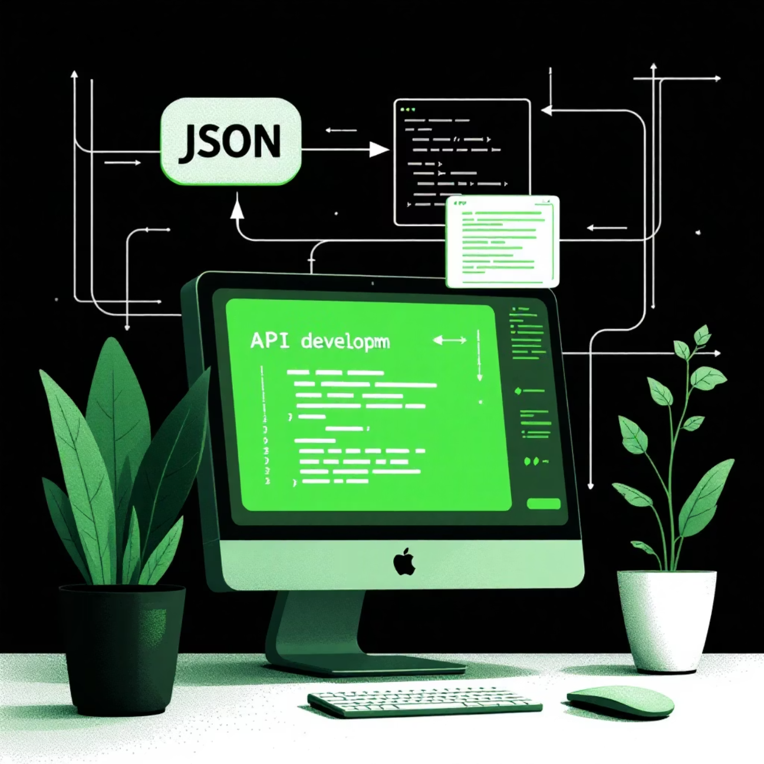
The Powerhouse for RESTful APIs
Express is the de facto standard for developing backend services and RESTful APIs due to its simplicity, speed, and excellent middleware support. It simplifies handling HTTP requests and responses, allowing developers to focus on business logic.
Build RESTful APIs Easily
Supports All Core HTTP Methods
Express provides simple, intuitive functions that map directly to the conventional REST API design patterns.
It offers robust support for the fundamental HTTP verbs: GET (read), POST (create), PUT and PATCH (update), and DELETE (remove).
JSON as Standard Data Format
Given its Node.js foundation, Express handles JSON seamlessly, making it ideal for data exchange between the server and client in modern applications.

Slide 5
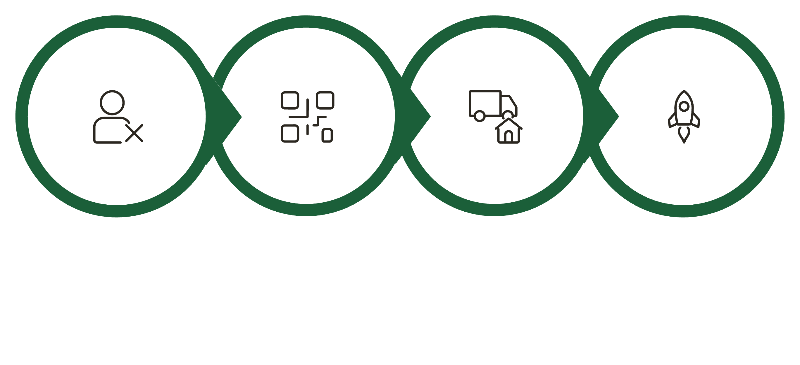




Accelerating Development with Express Generator
Starting a new project often involves repetitive setup tasks. The Express Generator is a command-line interface (CLI) tool designed to automate this process, enabling developers to jump straight into coding the unique features of their application.
Generate Boilerplate
Install Dependencies
Express CLI
Ready to Code
Express Application Generator Tool
Creates Boilerplate Code Quickly
Helps in Faster Project Setup
A powerful CLI utility that scaffolds the basic directory structure and files necessary for an Express application.
It sets up the initial views, public assets folder, and configuration files based on selected options (e.g., template engine).
By eliminating manual configuration of common modules, the generator significantly reduces initial development time and potential setup errors.

Slide 6




Essential Security: Authentication and Authorisation
Securing applications is paramount, and Express integrates easily with various tools and techniques to manage user access, ensuring that sensitive data and resources are only accessible to verified users.
User Login and Security Features
Middleware for Authentication
Protects Routes and Resources
Express provides the necessary hooks to implement custom login flows, handling user credentials securely during the process.
Popular libraries like Passport.js (flexible authentication middleware) and JSON Web Tokens (JWT) integrate seamlessly with Express routes to verify user identity.
Middleware functions are used to check authorisation status before executing route handlers, effectively blocking unauthorised access to protected API endpoints.
The concept of "Middleware" is central to Express. These are functions that have access to the request object, the response object, and the next middleware function in the application’s request-response cycle.

Slide 7




Managing State with Session Data
Because HTTP is stateless, sessions are essential to maintain user state and context across multiple requests. Express supports session management via middleware, which is critical for providing a personalized and continuous user experience.
Store User Session Data
Session data, often stored in a dedicated database (e.g., Redis) or memory, links a unique session ID to a user's information and preferences.
Track User Activity
Sessions allow the application to monitor and record a user’s navigation, preferences, and activity throughout their time on the site.
Implement Login Persistence
Features like 'Remember Me' rely on sessions to keep users authenticated and avoid requiring them to log in repeatedly, improving usability.

Slide 8
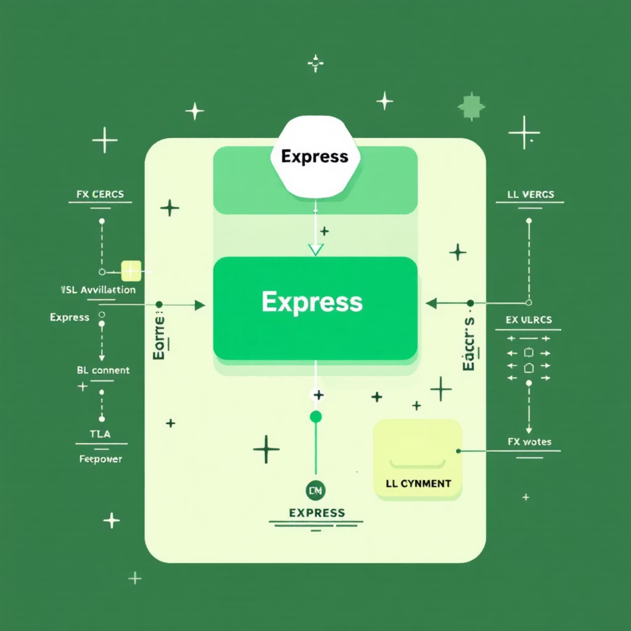

The Full-Stack Power of MERN/MEVN
Express is frequently paired with modern frontend libraries like React or Vue.js, forming robust full-stack application architectures (MERN and MEVN stacks). This combination leverages the strength of both declarative UI and fast, reliable backend APIs.
Combine Express with Modern Frontends
Use Express (backend) to provide data and business logic, while React or Vue.js (frontend) handles the user interface presentation.
API Communication via JSON
The frontend communicates with the Express backend using asynchronous requests (e.g., Axios or Fetch), sending and receiving data primarily in the JSON format.
Build Scalable Full-Stack Applications
This separation of concerns leads to highly maintainable, scalable, and performant modern applications, essential skills for any computer science graduate.

